Slide 1

Create A Green World
2005 --- --- 2026

Slide 2
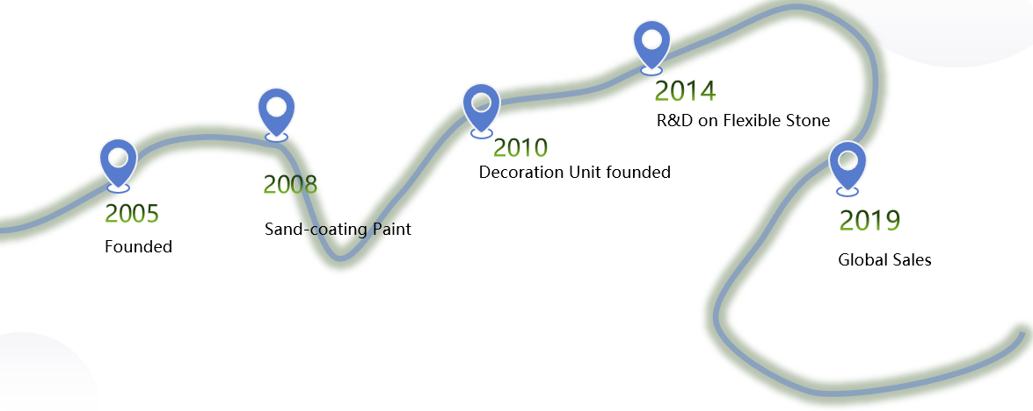
The Company
Founded in year of 2005, Jiangsu Baidai Energy-Saving Building Material Co., Ltd has become a comprehensive high-tech enterprise integrated with R&D, Production, Market Sales, Project Management and Technical Solutions.
As the interior and exterior decoration system provider, the company has been providing diversified products and service with continuous upgrade and innovation to create more value for our clients and to make the building green and safe.
Currently we have the capacity of flexible stone up to 4.5M Sqm and sand-coating paint up to 50,000 tons.

Slide 3
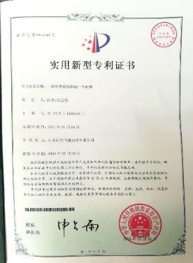
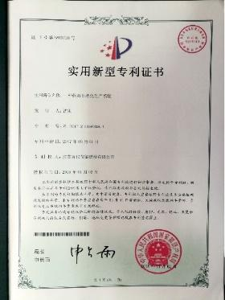
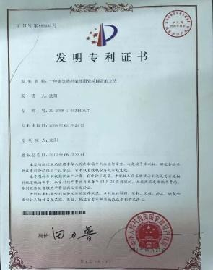
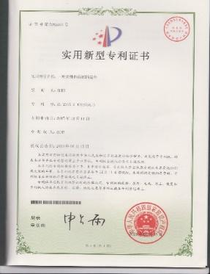
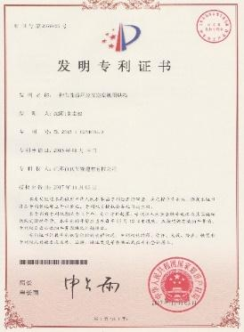
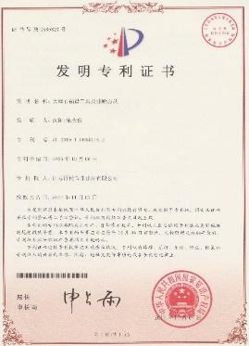
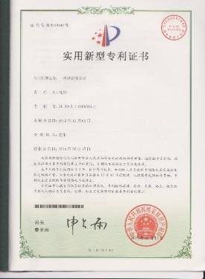
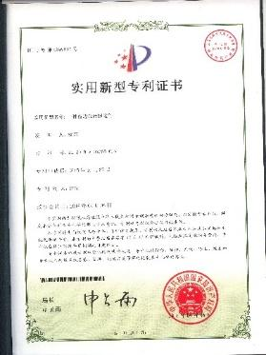
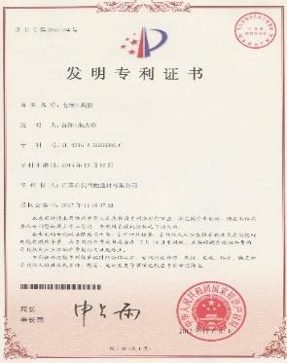
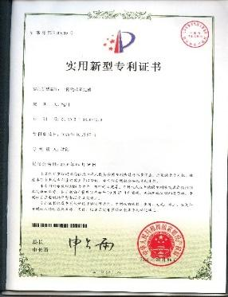
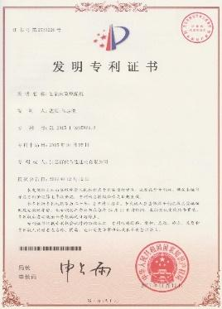
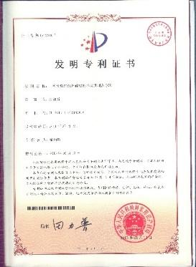
The Patent
More than 40 National Patents

Slide 4
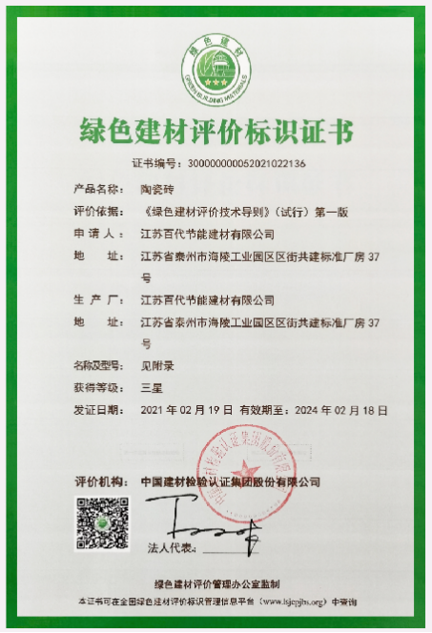
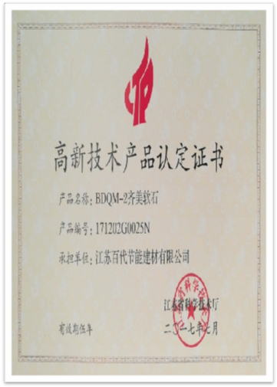
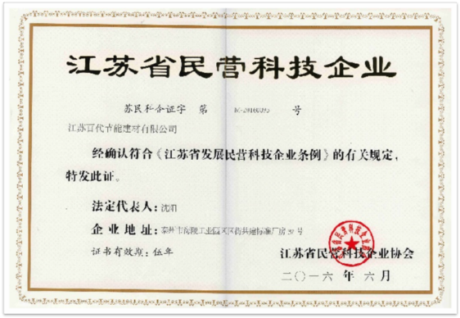
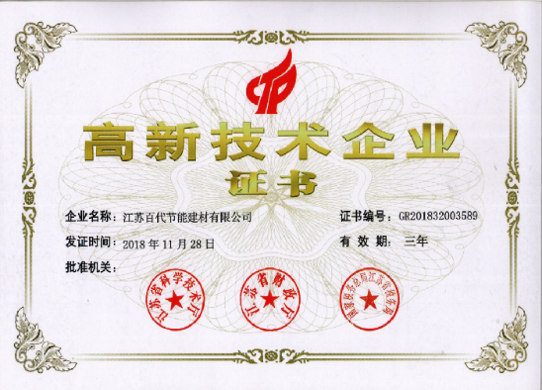
The Honor
High-Tech Product Certificate and High-Tech Enterprise Certificate by Jiangsu Provincial Government
Green Building Material Assessment Certificate by China Building Material Association

Slide 5
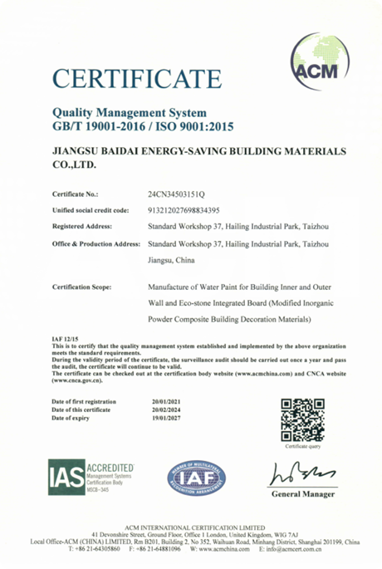
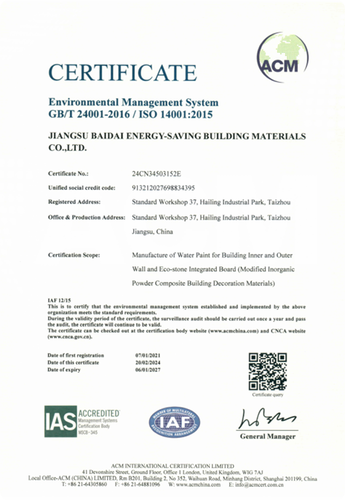
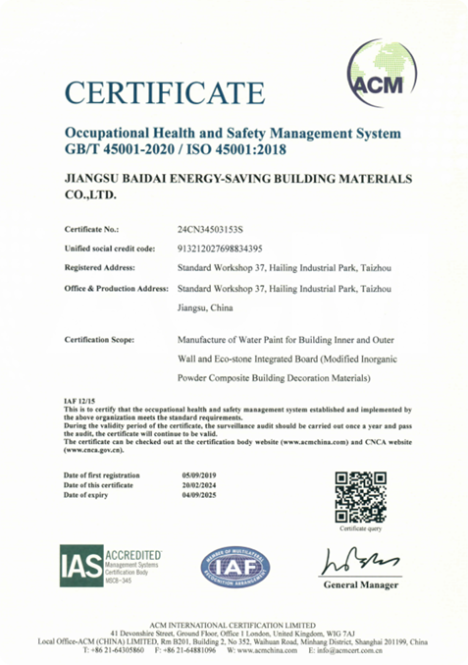
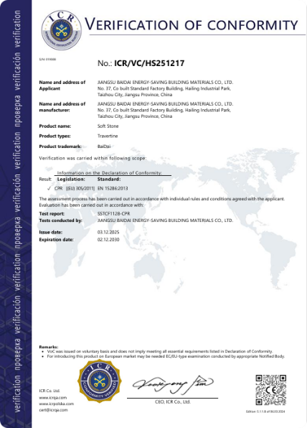
The Certificate
ISO9001
ISO14001
ISO45001
CE
ISO9001
ISO14001

Slide 6
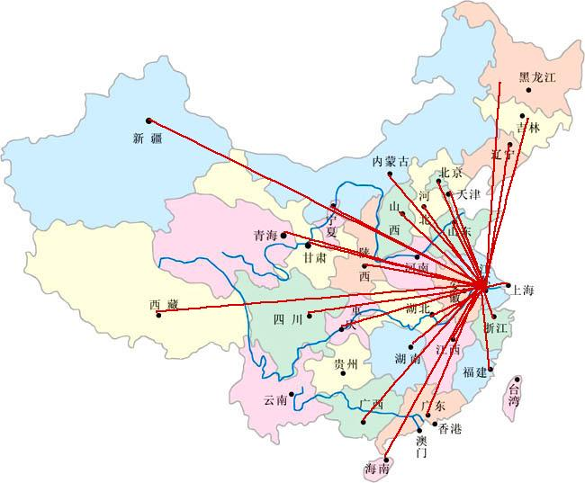
The Domestic Coverage

Slide 7

The Oversea Coverage
We will launch local depot with our partners in the next 5 years business development plan.

Slide 8
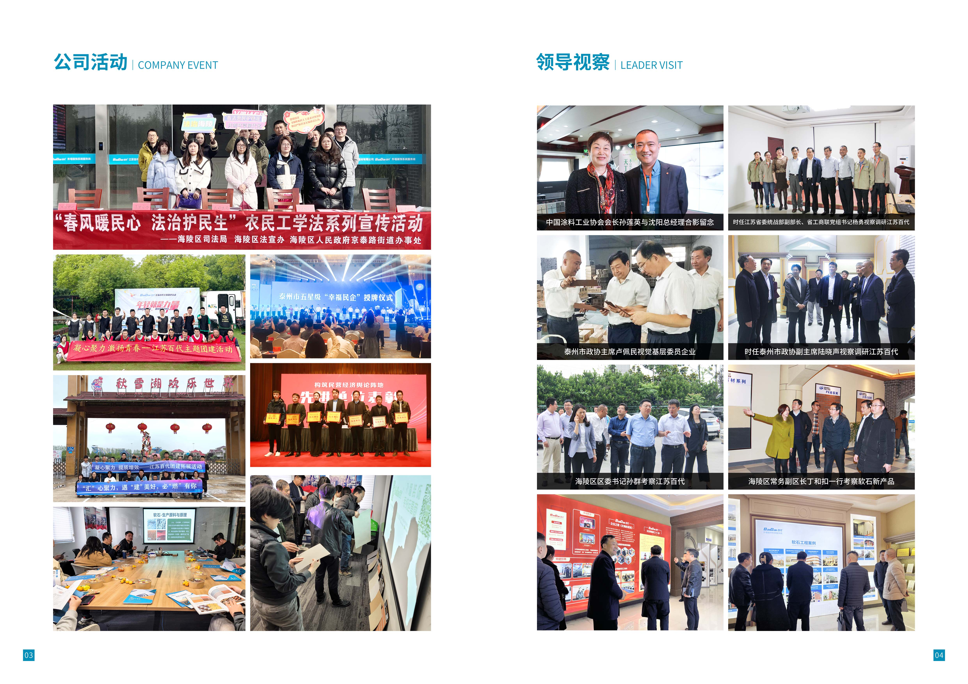
The Activity

Slide 9
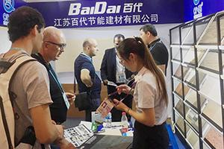
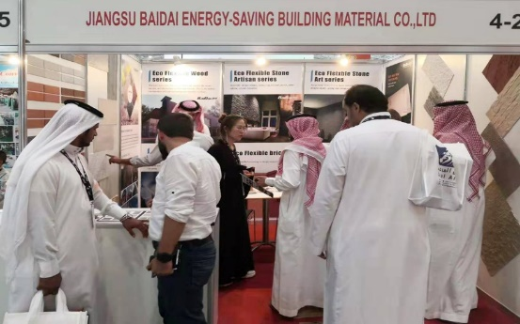
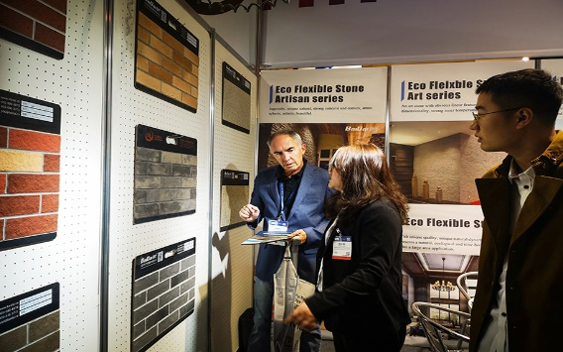
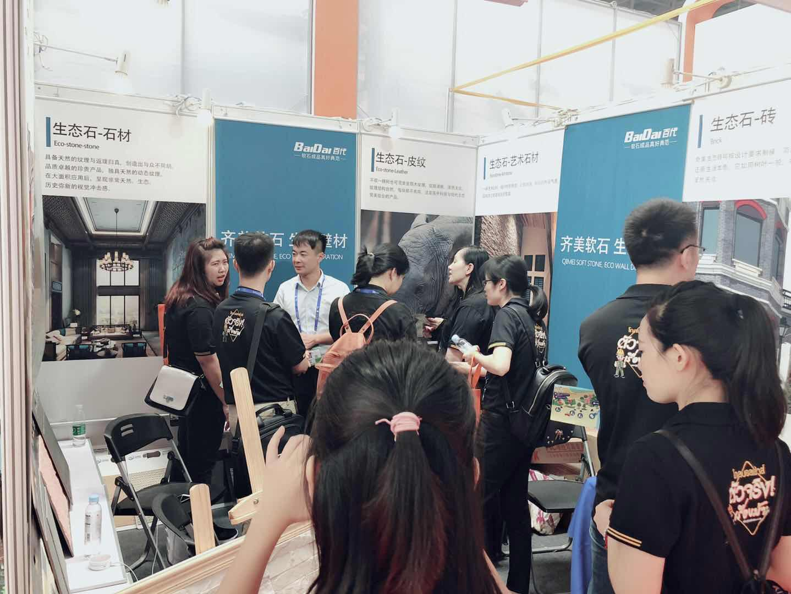
The Exhibition
Canton Fair
Saudi Big 5 Expo
International Stone Expo Las Vegas
ASA Building Material Expo

Slide 10
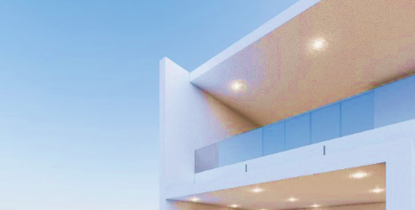
The Product
产品场景图4张（内2外2），
大面积的铺装

Slide 11
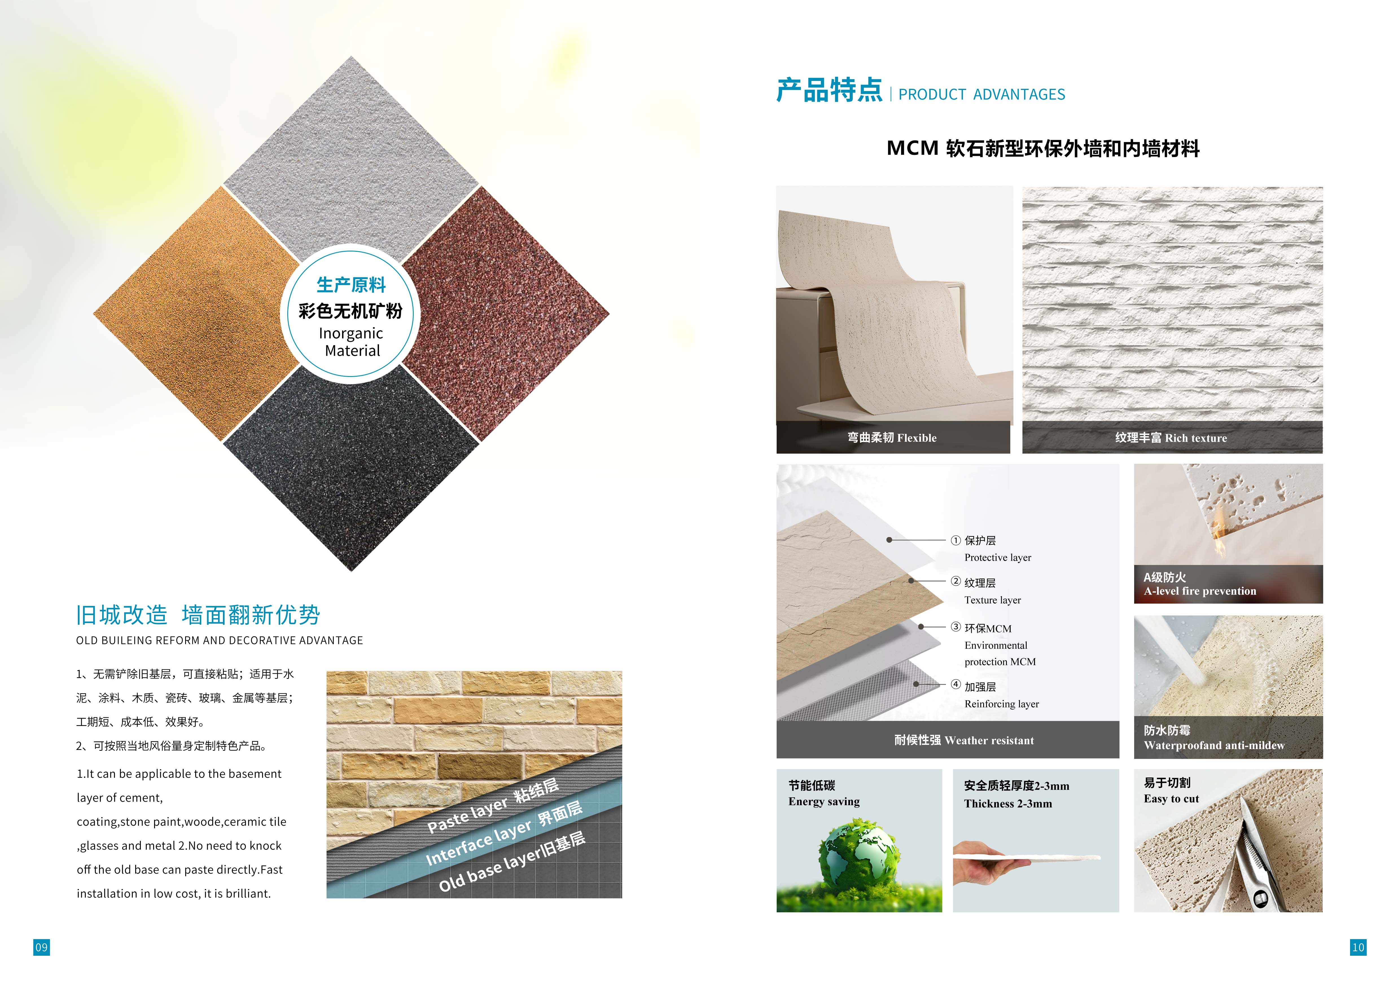
The Raw Material and Construction
箭头这张图用大图

Slide 12
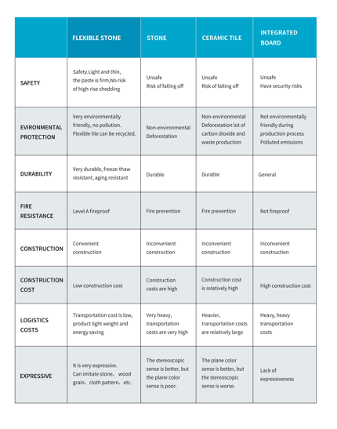
The Comparison and Performance
S/N | Content | Unit | Modified inorganic compound building surface standard value JC/T 2219--2014 |  |  | Product Actual Value
1 | Water absorption | % | ≤15 |  |  | 7
2 | Alkali resistance（48h） | / | No crack ,peel and blistering on sample surface and a slight color change compared to non-soaking sample is allowed |  |  | No abnormalities
3 | Flexibility | / | No crack when bending on cylinder with diameter of 200mm |  |  | No cracks for 3 samples
4 | Stain resistance | G | 3D | ≤1（Grade Ⅰ） | ≤2（Grade Ⅱ） | Grade Ⅰ
5 | Heat resistance | / | No crack, peel and blistering after 15 times of circular testing. No obviously color change |  |  | No abnormalities
6 | Durability | / | No crack, peel and blistering after 2000h,pulverization≤1，color change≤2 |  |  | 3500h no pulverization

Slide 13
The Standard and Test
S/N | Item | Unit |  | Execution Standard | Baidai Value测
1 | Antifreezing | / | No crack, pulverization and layer after 15 times circular testing under the regulations of JG/T25 |  | 25 times circular testing
2 | Heat Resistance | / | No bubble and sticky on the surface under the experimental method of GB/T4085 for heating |  | Qualified
3 | Durability | Grade | 2000H | No crack and pulverization under GB/T16259 | 3500H no pulverization and no color change
4 | Stain resistance | Grade | ≤1(flat surface) | ≤2(Concave and convex surface) | Grade 1
5 | Chemical resistance |  | Soak in 3% hydrochloric acid and 3% potassium hydroxide solution for 12days until to find if there Is crack ,layering and obvious color change |  | No crack, layering and obvious color change
6 | Fire resistance | Grade | GB8624-2012 |  | Grade A
National Building Industry Standard for flexible brick
JG/T 311-2011
National Building Industry Standard for modified inorganic compound building surface
JC/T 2219-2014

Slide 14

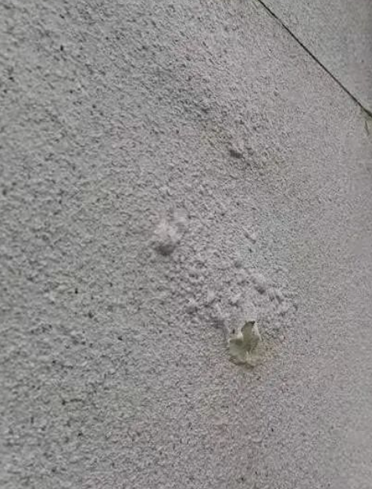
The Technical Q&A
1：Bubbling
Specific Description: Some soft stone veneer is bubbling, with the top coating powdering and peeling off.
Causes and Analysis: If a standard adhesive was not used during construction, and the backing was not fully covered with mortar, the bond will be weak and unreliable, allowing rainwater to seep through the gaps to the backing.
During the rainy season, the adhesive layer is constantly soaked in rainwater, becoming loose. After rain, sunlight causes moisture evaporation, lifting the surface sheet and creating hollow areas. This repeated process causes the surface material to bubble, powder, and eventually detach due to the loss of strength in the base material.
Preventive Measures
1. Before construction, check the exterior walls for water seepage. Make sure to eliminate any seepage points before installing the soft stone tiles to avoid unnecessary damage. Drainage outlets for accumulated water on the floors should be located at least 80 cm outside the scaffolding, ensuring the tiles are not wetted.
2. For outdoor construction, check the weather forecast for the next few days beforehand. Construction can proceed when there is no rain or snow and the temperature is between 5℃ and 40℃. Avoid direct rain; if it is raining, take precautions to protect the area from rain.
3. Use Baidai flexible stone-specific Dual-component adhesive. Its excellent bonding strength and good water resistance can prevent bubbling.

Slide 15
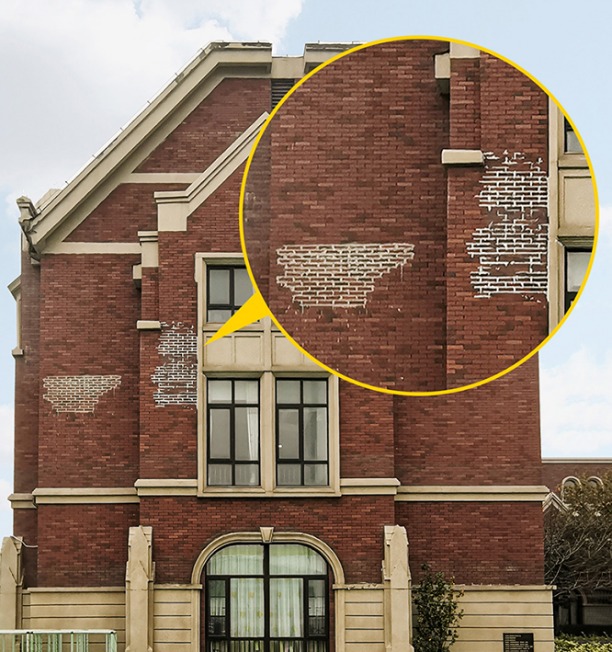
The Technical Q&A
2: Efflorescence
Specific description: Surface efflorescence, difficult to clean
Causes and analysis: Calcium and magnesium ions in the cement base combine with water and oxygen in the air over a long period of time to form white limestone-like calcium carbonate and magnesium carbonate.
Preventive Measures: Baidai soft stone uses inorganic mineral powder as its raw material. No organic pigments or other alkaline substances are added during production, ensuring a stable raw material structure. Specialized interface treatment agents, adhesives, and grouts ensure that the soft stone system, from main materials to auxiliary materials, constitutes an alkali-free system, containing no cement-based components. Before construction, a coat of alkali-resistant primer is applied to the walls to seal the cement-based components. This prevents efflorescence later, ensuring project quality and reducing rework and maintenance costs.

Slide 16
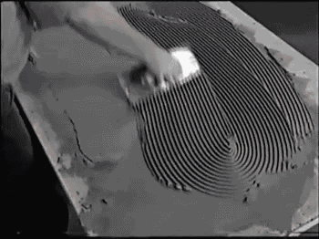
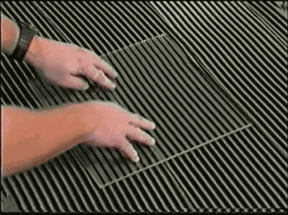
The Technical Q&A
3: Loosening and hollowing after installation
Specific Description: The soft stone and adhesive are fine, but there are still hollow areas.
Causes and Analysis: Incorrect application techniques reduce the bonding area between the adhesive and the soft stone, weakening the bond and making hollow areas more likely. Furthermore, due to stress between the soft stone and adhesive over time, areas with thicker adhesive are prone to cracking and prying, while thinner areas, lacking adequate thermal expansion and contraction, exacerbate deformation.
Preventive measures: Follow the correct procedures outlined in the "Construction Instructions" provided by Baidai:
1. Apply mortar to both the wall and brick surfaces. After fully applying the mortar, use a notched trowel at an angle of less than 45 degrees to comb the adhesive into strips from top to bottom or bottom to top. When combing with the notched trowel, it must be pressed firmly against the back of the board to ensure sufficient mortar thickness. The back of the brick should be fully covered with mortar, and the adhesive layer thickness should be approximately 2-3mm.
2. Tile Compaction: Within the marked area, first compact the four corners of each tile. Then, use a plastic tampon to evenly compact it, ensuring a firm bond with the base layer and a smooth, level surface with the surrounding tiles, free of hollow spots. Avoid smoothing or pressing the surface of the tiles by hand during installation to prevent depressions. Depending on the season and temperature, the position of the tiles can be adjusted after installation. However, tiles should not be moved more than 5 minutes after installation to avoid affecting the adhesive's bonding strength. During construction, use a straightedge to check for horizontality, verticality, and flatness at all times.

Slide 17
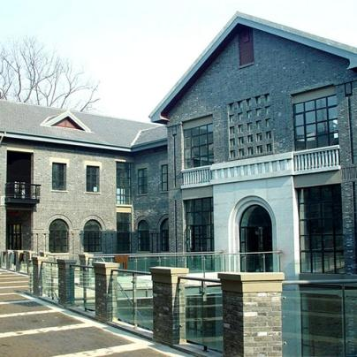
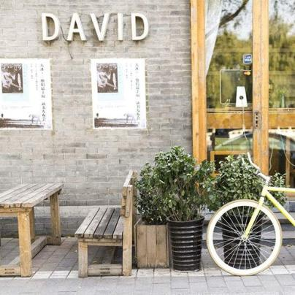
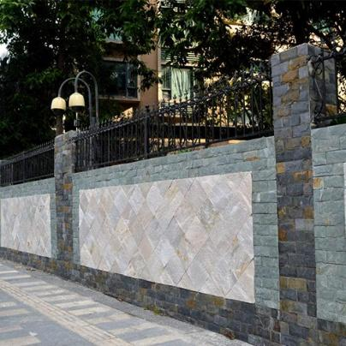
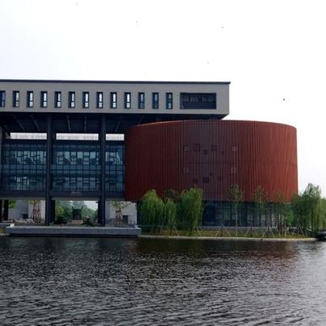
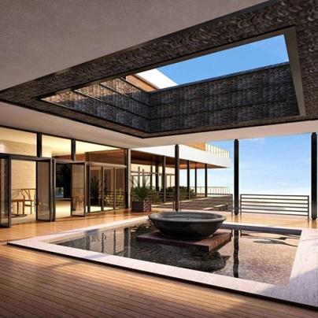
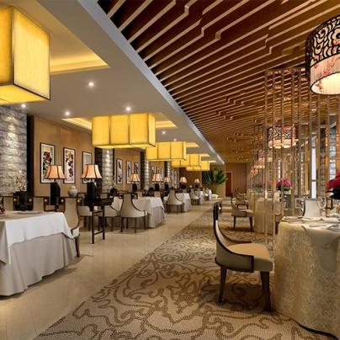
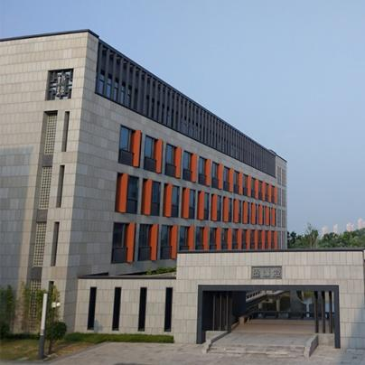

The Application

Slide 18
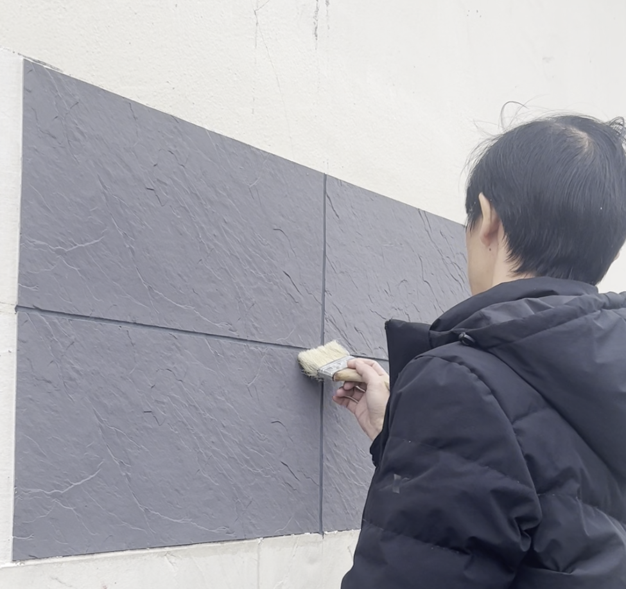







The Advantage
Energy Saving and Eco-Friendly
Fire proof
Water proof
Flexible and applicable
Higher Standard and quality assurance
Easy Installation
Durable

Slide 19
The Installation
此处放入安装视频和安装图片
安装图片要求详细高清

Slide 20
The Package
此处放入600*1200包装尺寸示意图及最终成品打托图片及装箱图片
图片要求详细高清

Slide 21
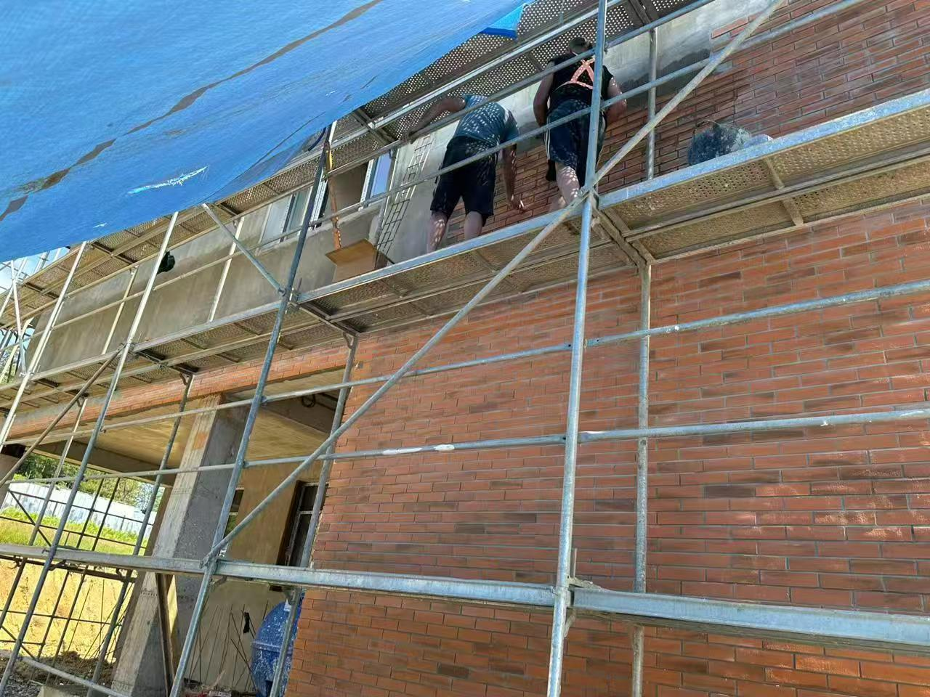
The Project
Tibulisi Georgia 6,000sqm K-Brick

Slide 22
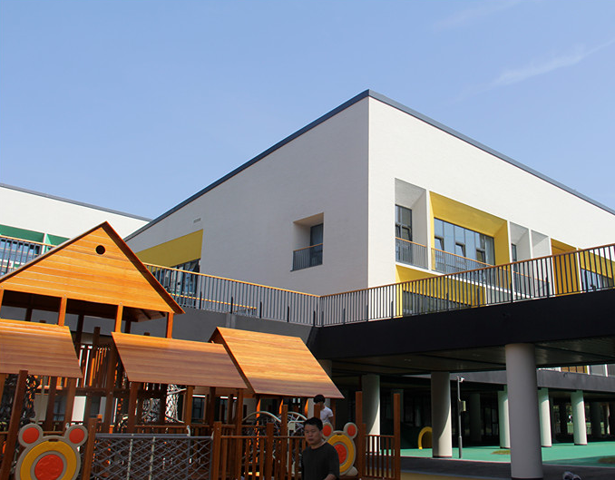
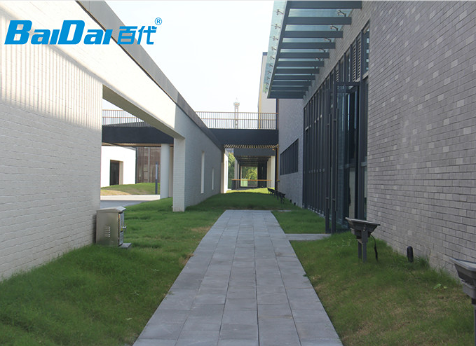
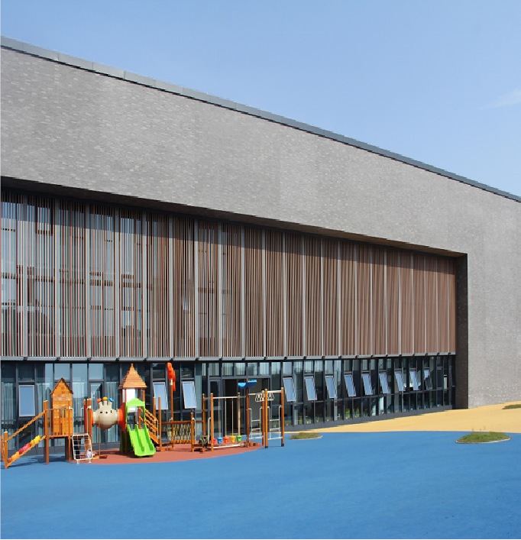
The Project
Peking Normal University Yancheng 24,000sqm

Slide 23
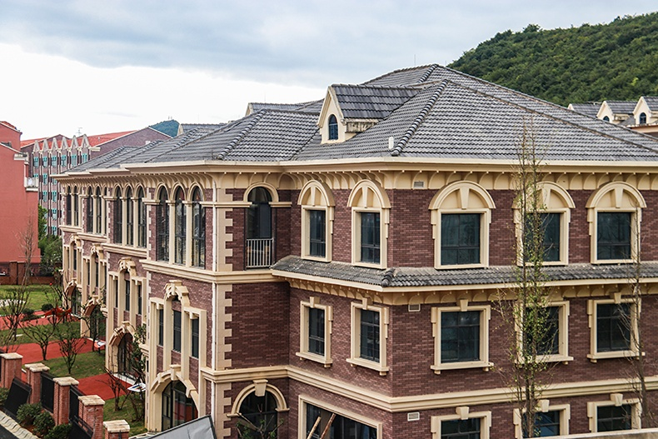
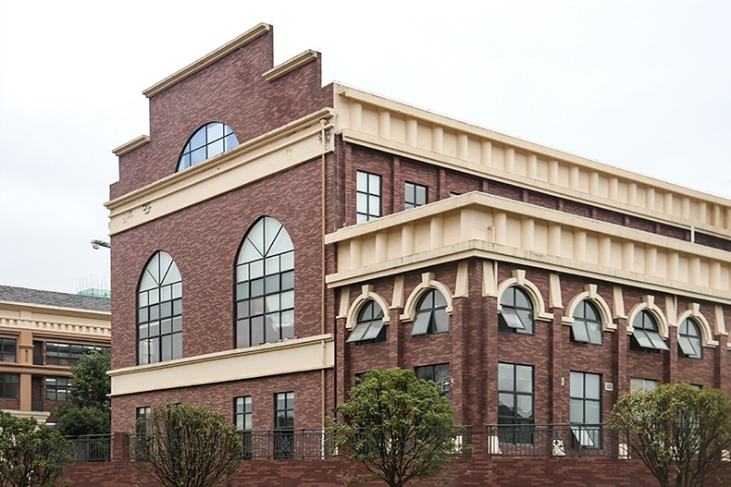
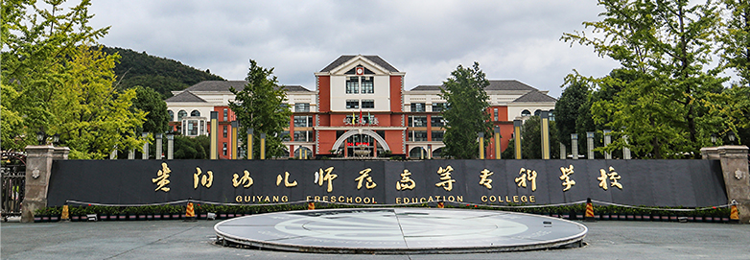
The Project
Guiyang City 12,000sqm Clay Brick

Slide 24
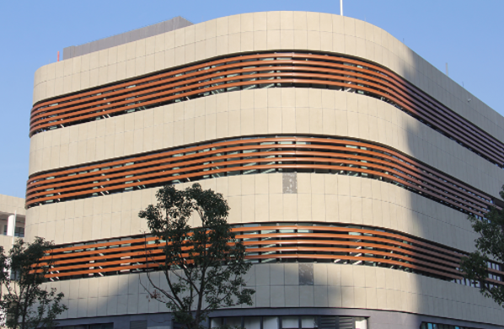

The Project
Wuxi 10,000sqm Flexible Stones

Slide 25


The Project
Anhui 20,000sqm Kiln Culture Brick

Slide 26



The Project
Guiyang 15,000sqm Slate

Slide 27


The Project
Changzhou 3,000sqm Wood grain and Mushroom

Slide 28


The Project
Nanjing 10,000sqm Travertine

Slide 29


The Project
Suzhou 10,000sqm Saipan Times

Slide 30



The Clients

Slide 31
Thanks!

